Slide 1


Xccelerate.co
Data Science - Tableau Part I
Topics Covered:
Intro to Tableau
Tableau operations

Slide 2


Tableau’s History
US Company (2003) - Stanford alumni
Muli-product (Main focus: Tableau Public)
By 2019 - Bought up by Salesforce > $15B USD (vs AAPL $2.1T)
0.7% of AAPL’s mkt cap
~1.4% of GOOL’s mkt cap
Simple & powerful BI tool that has emphasis on Data viz
Notes:
https://forms.gle/jnob3YLb33f7Zxcw5 - Feedback form

Slide 3
Tableau in a nutshell
• Unlike Python, but like other BI tools, Tableau is primarily a drag-and-drop software
• Tableau takes input from…
query relational databases (MySQL Server (Paid)...),
cloud databases (Google Drive, Azure (Paid),AWS…...)
Spreadsheets (xls, statistical file, pdf, JSON…)
To generate interactive visualizations.
Notes:
https://forms.gle/jnob3YLb33f7Zxcw5 - Feedback form

Slide 4
Why do we use Tableau
Tableau has a fast growing community
But most importantly, Tableau uses an engine VizQL !!
- VizQL combines query, analysis and visualization into single framework
- Built-in Query Analyzer compiles VizQL automatically to SQL if needed
- Allows for VizQL to be used against almost any data source

Slide 5
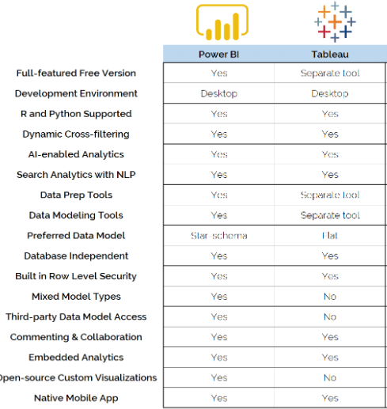
Tableau Basics
Major Differences
Cross-platform
Free/ Paid
Query Performance

Slide 6
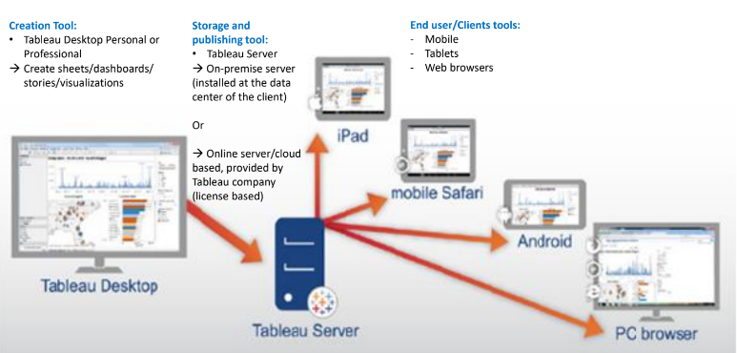
Tableau Architecture
Note: Limitations of Tableau Public

Slide 7
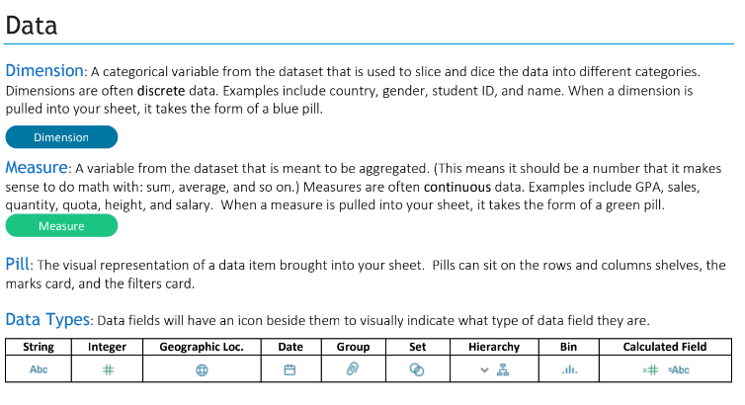
Tableau Basics
Notes:
Our next round of bootcamps begin next Monday 4 April! If you’re interested in signing up, you will need to complete your application by Friday 1 April.
We strongly encourage those of you interested in pursuing a career in tech to join our April cohort. As you can see, we’ve provided a limited time offer for $29,999 to make it more accessible during these challenging covid times. We also have adjusted the timetable for lunch hour lectures, to allow those of you who are unable to quit your job to study and work at the same time.
We will share further information at the end, including the application form.

Slide 8
Install Tableau Public
Sign up/ check Google Drive
Notes:
https://forms.gle/jnob3YLb33f7Zxcw5 - Feedback form

Slide 9
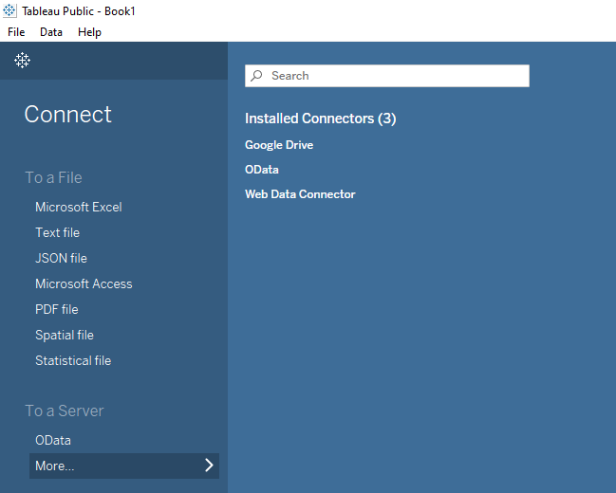
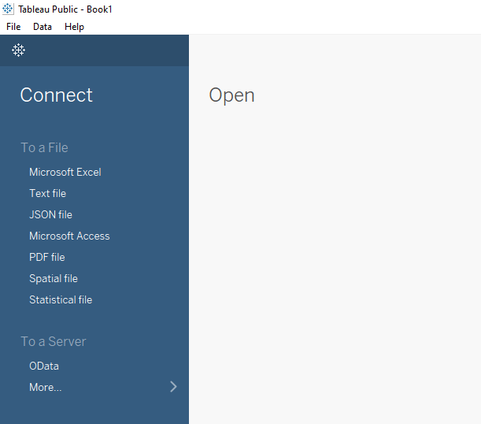
Tableau Interface overview:
Connect
More…

Slide 10
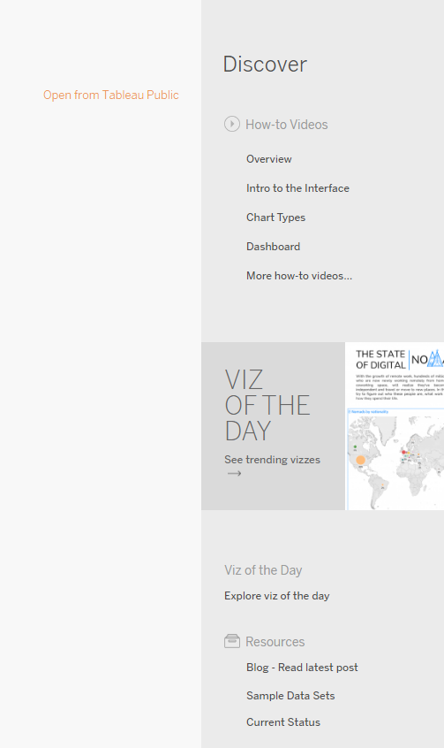
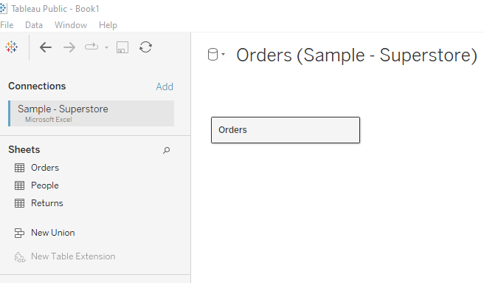
Tableau Interface overview:
Discover
Blogs, training …
Now is the time to…
Connect to the SuperStore: .xls sheet
And..
Drag the tables in:
Only drag…
Orders (sheet)

